Slide 1
Strengthening the External Locus of Hope:
Suicide Prevention in Youth
Jonathan Kratz, MSW, LCSW
Graduate Coordinator
Clinical Assistant Professor

Slide 2
Epidemiology
The Status Quo
Hope Theory as a heuristic for Screening, Assessment, and Treatment
{
Suicide Prevention in Youth

Slide 3
Epidemiology
33% increase between 1999 and 2017
47,000 p/year
10th leading cause of death
More than motor vehicle accidents
Centers for Disease Control and Prevention. Suicide Mortality in the United States, 1999–2017. Available at https://www.cdc.gov/nchs/data/databriefs/db330-h.pdf. Accessed November 30, 2018.
Firestone, L. Suicide: What Therapists Need To Know. Available at https://www.apa.org/education/ce/suicide.pdf

Slide 4
For every who dies by suicide…
will attempt.
Notes:
1:12

Slide 5
For every who dies by suicide…
will attempt.
Notes:
1:30

Slide 6
For every who dies by suicide…
report making a plan.
Notes:
1:60

Slide 7
For every who dies by suicide…
report having serious thoughts.

Slide 9
24 & younger
25 and older

Slide 10
24 & younger
2nd leading cause of death.

Slide 11
24 & younger
↑56%

Slide 12
X4
X3
Centers for Disease Control and Prevention 2017

Slide 13
X4
X3
Centers for Disease Control and Prevention 2017

Slide 14
5X more likely to attempt suicide
8.5X more likely to attempt if there is family rejection.
Nearly 1/2 of all transgender youth will attempt suicide by age 25.

Slide 17
ACEs
% attempted suicide

Slide 19
Alonzo and Gearing, 2018
Alonzo and Gearing, 2018

Slide 20
Alonzo and Gearing, 2018

Slide 21
The Status Quo
Qin P, Nordentoft M. Suicide Risk in Relation to Psychiatric HospitalizationEvidence Based on Longitudinal Registers. Arch Gen Psychiatry. 2005;62(4):427–432. doi:10.1001/archpsyc.62.4.42
Suicide Within Two Weeks of Discharge From Psychiatric Inpatient Care: A Case-Control Study. PSYCHIATRIC SERVICES ' ps.psychiatryonline.org ' July 2013 Vol. 64 No. 7

Slide 22
Talking About Suicide

Slide 23
Warning Signs & Risk Factors
Agitation/anxiety/impulsivity/anger
Dramatic change in mood
Frequent, intense suicidal thoughts/imagery
Talking and/or writing about suicide
Increase in drug use
Sleeping too little or too much
Making preparations
Rehearsal or recent/current attempt
Withdrawal from others
Family conflict
Feeling like a burden to others
Talking about feeling hopeless or trapped
Talking about experiencing unbearable pain.
Easy access to means
Adapted from Freedenthal, 2018

Slide 24
Hope Theory
Willpower
GOALS
Way-power
Gwinn & Hellman (2018). Hope Rising: How the Science of Hope Can Change Your Life. Morgan James Publishing: New York.

Slide 25
Hope Theory
APATHY
Willpower
DESPAIR
RAGE
REDUCE PAIN
Way-power
🚫
Gwinn & Hellman (2018). Hope Rising: How the Science of Hope Can Change Your Life. Morgan James Publishing: New York.

Slide 26
Hope Theory
APATHY
DESPAIR
RAGE
REDUCE PAIN
SUICIDE
What problem would suicide solve for you?
If we could solve that problem in some other way, would you still want to die?
Gwinn & Hellman (2018). Hope Rising: How the Science of Hope Can Change Your Life. Morgan James Publishing: New York.

Slide 27
The Difficult Question(s)
The literature supports two persistent approaches: Direct or Hierarchical
Euphemisms are never recommended.
Joiner et al, 2009
Adapted from Freedenthal, 2018

Slide 28
Crisis Interventions for Suicidality
Crisis Hotline
Crisis intervention are the standard, but there is very little evidence of efficacy.
Best when used to intervene with suicidality that is occurring in response to a crisis (less so when suicidality IS the crisis).
Primary function is to connect a person to a live clinician
Crisis Centers
Online Crisis Intervention (new, very little data)
Mobile Methods (COPES)
911
HELP!
HELP!
HELP!
HELP!
HELP!
HELP!
HELP!
HELP!
Alonzo & Gearing, 2018
Notes:
Facebook story - inviting not to tell

Slide 29
Who should screen? EVERYONE.
Social Workers
Counselors
Law enforcement
Firefighters
EMS
Doctors
Nurses
School Employees
Physical Therapists
Clergy
Pharmacists
Q
Direct or hierarchical screening question
“Will you…
…go with me to get help?
…let me help you get help?
P
R
Take them to help, assist them in making arrangements, give a referral and seek commitment.

Slide 30
Assessing
Suicide

Slide 31
Assessment = Conceptualization
APATHY
DESPAIR
RAGE
REDUCE PAIN
Indirect & Direct
Drivers
SUICIDE
BLOCKED PATHWAYS
Gwinn & Hellman (2018). Hope Rising: How the Science of Hope Can Change Your Life. Morgan James Publishing: New York.

Slide 32
Meet them ‘where they are’
Evoke the client’s “reasons for dying”
Ask for clarification: “Can you help me to understand the pain that you’re in. What am I missing?”
Validate the ‘reasons for dying’ -
Empathy, not agreement/affirmation (Linehan)
“It’s understandable that you are experiencing these feelings in light of the pain and suffering you’ve described”
Adapted from Freedenthal, 2018

Slide 33
Suicidal Storytelling
Engagement vs Data collection
Instead of interrogation, focus on letting the client feel heard, understood, and less alone.
“Could you tell me how you got to the point that you wanted to put an end to your life?”
“I would like to hear the story of what led you to consider suicide. Would you be willing to tell me your story?”
(Valach, 2011)

Slide 34
Essential Data
Suicidal Thoughts and images (flash-fowards)
Reasons for wanting to die (sometimes framed as triggers)
Frequency of thoughts/images
Intensity of thoughts/images (‘desire to die ‘scale)
Duration (when was the first time, how long do they last)
Method/Means
Preparation/Planning
Googled ways to die by suicide
Intent and Timing (are you going to do this today or later?)
Controlability- can you resist the thoughts and impulses?
History - have you attempted suicide before? NSSI?
Impulsivity, nervous energy
What is the person’s own assessment of their suicide risk?
Adapted from Freedenthal, 2018

Slide 35
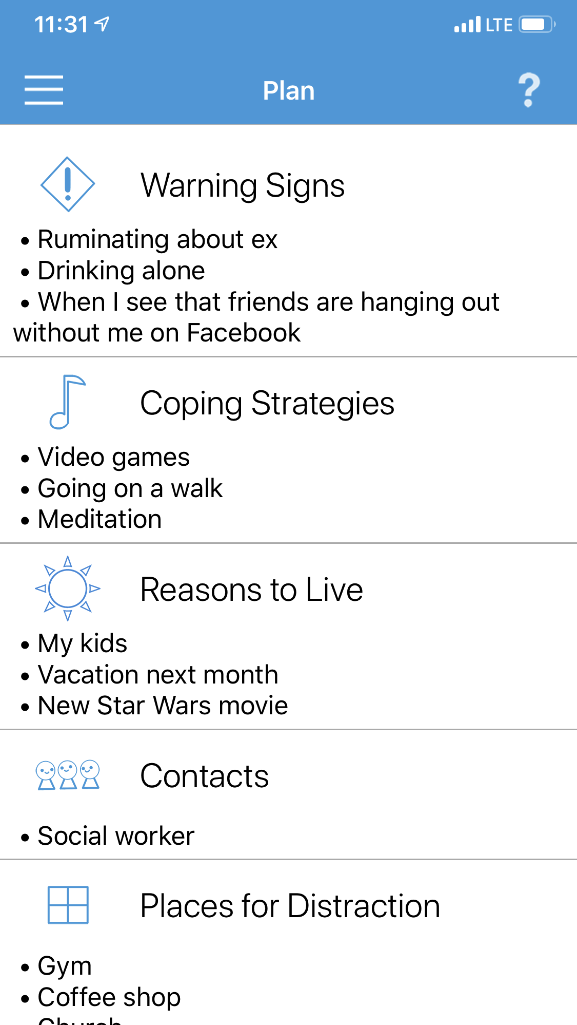
Treatment

Slide 36
Outpatient Treatment
Suicide should be the focus
Stabilization - make a plan & give them coping options
Identify top drivers of suicidality
Involve family & friends
Ask them to delay, lets take suicide off the table for a while and try different coping instead
Reduce or eliminate access to means
Adapted from Freedenthal, 2018

Slide 37
Treatment & Hope Theory
APATHY
Motivation (Willpower)
DESPAIR
RAGE
REDUCE PAIN &
Treatment Outcomes
SUICIDE
Interventions (Pathways)
Gwinn & Hellman (2018). Hope Rising: How the Science of Hope Can Change Your Life. Morgan James Publishing: New York.

Slide 38
Motivational Interviewing
Additional TX
Help youth to include family
Brief treatment & means restriction counseling
RFL + RFD directly translate to MI concepts of change and sustain talk.
‘Reversed’ transtheoretical perspective
An important transitional modality to build the Willpower to fully pursue the pathways (interventions).
MI
Assessment
Alonzo & Gearing, 2018
Britton, P., Bryan, C., &Valenstein, M. (2016).

Slide 39
CBT
Only options are to live a miserable life or die.
Because my girl/boyfriend left
me, I will never feel loved again.
I tried to connect with friends this weekend, but no one was available so I’m going to be alone forever…
It’s not a big deal if I kill myself, my parents will move on.
I feel like a burden to everyone, so I must be a burden and they’d be better off if I were dead.
It’s my fault when bad things
happen.
Alonzo & Gearing, 2018

Slide 40
Dialectical Behavior Therapy
Conceptualization = emotional dysregulation
DBT informed use of Chain Analysis
DBT Skills Groups
Alonzo & Gearing, 2018

Slide 41
Treatment & Hope Theory
Motivation (Willpower)
REDUCE PAIN &
Treatment Outcomes
Interventions (Pathways)
Gwinn & Hellman (2018). Hope Rising: How the Science of Hope Can Change Your Life. Morgan James Publishing: New York.

Slide 42
Treatment & Hope Theory
Motivation (Willpower)
REDUCE PAIN &
Treatment Outcomes
External Locus of Hope
EXTERNAL LOCUS
Gwinn & Hellman (2018). Hope Rising: How the Science of Hope Can Change Your Life. Morgan James Publishing: New York.

Slide 43
Interpersonal Psychotherapy
Assess the social and interpersonal context
Develop strategies to address interpersonal problems
Intrapersonal strategy for improving interpersonal problems.
Alonzo & Gearing, 2018

Slide 44
Attachment-Based Family Therapy
Suicide is conceptualized as blocked pathways in family Interactions.
Adolescent: “When I’m feeling bad, I just want to go to my room. I don’t want to talk to anyone, especially my parents. It would be embarrassing and they don’t know what to say anyway.”
Clinician: “You’d rather kill yourself than feel embarrassed or make your parents uncomfortable.”
Emotional Coaching
Identify patterns that are invalidating, critical, dismissive, & self-involved
Attachment repairing skills: validation, affirmation, support
Desired outcome: parent as a safe and secure source of support for child.
Singer, O’Brien, & LeCloux, 2016

Slide 45
Multisystemic Family Therapy
Community/Culture
School
Peers
Family
Child

Slide 46
Hope as a Parallel Process
Willpower
GOALS
Way-power

Slide 47
References:
Alonzo, Dana & Gearing, Robin. (2010). Suicide Assessment and Treatment; Empirical and Evidence-Based Practices.
Centers for Disease Control and Prevention. Fatal injury data, 2015. Web-based Injury Statistics Query and Reporting System. Available at www.cdc.gov/injury/wisqars/fatal.html. Accessed September 23, 2017.
Cheryl Regehr, Marion Bogo, Vicki R. LeBlanc, Stephanie Baird, Jane Paterson & Arija Birze (2016) Suicide risk assessment: Clinicians’ confidence in their professional judgment, Journal of Loss and Trauma, 21:1, 30-46
Chino M, & Chino M;Fullerton-Gleason L. (2006). Understanding suicide attempts among American Indian adolescents in New Mexico: Modifiable factors related to risk and resiliency. Ethnicity & Disease., 16(2), 435.
Draper, B., Snowdon, J., & Wyder, M. (2008). A pilot study of the suicide victim’s last contact with a health professional. Crisis, 29, 96–101.
Firestone, L. Suicide: What Therapists Need To Know. Available at https://www.apa.org/education/ce/suicide.pdf
Harvard NVISS Pilot 2007
Hottes, T. S., Bogaert, L., Rhodes, A. E., Brennan, D. J., & Gesink, D. (2016). Lifetime Prevalence of Suicide Attempts Among Sexual Minority Adults by Study Sampling Strategies: A Systematic Review and Meta-Analysis. American Journal Of Public Health, 106(5), e1-e12.
Jobes, D.A., (2016). Managing Suicidal Risk: A Collaborative Approach 2nd Ed. New York: The Guilford Press.
Luoma, J., Martin, C., & Pearson, J. (2002). Contact with mental health and primary care pro- viders before suicide: A review. American Journal of Psychiatry, 159, 909–916.
Montague, K. T., Cassidy, R. R., & Liles, R. G. (2016). Cou Selor Training in Suicide Assessment, Prevention, and Management. American Counseling Association VISTA Program.
Sawyer, C., Peters, M. L., & Willis, J. (2013). Self-efficacy of beginning counselors to counsel clients in crisis. The Journal of Counselor Preparation and Supervision, 5(2), 30–43.
Schmitz, W. J., Allen, M. H., Feldman, B. N., Gutin, N. J., Jahn, D. R., Kleespies, P. M., & Simpson, S. (2012). Preventing suicide through improved training in suicide risk assessment and care: An American association of suicidology task force report addressing serious gaps in U. S. mental health training. Suicide and Life- Threatening Behavior, 42(3), 292–304.
Substance Abuse and Mental Health Services Administration, Results from the 2013 National Survey on Drug Use and Health: Mental Health Findings, NSDUH Series H-49, HHS Publication No. (SMA) 14-4887. Rockville, MD: Substance Abuse and Mental Health Services, 2014. Available at http://www.samhsa.gov/data/ sites/default/ les/NSDUHmhfr2013/NSDUHmhfr2013.pdf.
Summary of Violent Deaths in Oklahoma, Oklahoma Violent Death Reporting System, 2004-2007, Injury Prevention Service, Oklahoma State Department of Health.
Suicide and Life-Threatening Behavior (2012). The American Association of Suicidology
Wozny, D. A. (2005). The prevalence of suicide and violence assessment/intervention courses in CACREP- and COAMFTE-accredited counseling curriculums. In Ideas and research you can use: VISTAS 2005. Retrieved from https://www.counseling.org/resources/library/vistas/vistas05/Vistas05.art59.pdf
CDC. (2016). Sexual Identity, Sex of Sexual Contacts, and Health-Risk Behaviors Among Students in Grades 9-12: Youth Risk Behavior Surveillance. Atlanta, GA: U.S. Department of Health and Human Services.
Family Acceptance Project™. (2009). Family rejection as a predictor of negative health outcomes in white and Latino lesbian, gay, and bisexual young adults. Pediatrics. 123(1), 346-52.
James, S. E., Herman, J. L., Rankin, S., Keisling, M., Mottet, L., & Anafi, M. (2016). The Report of the 2015 U.S. Transgender Survey. Washington, DC: National Center for Transgender Equality.

