Slide 1
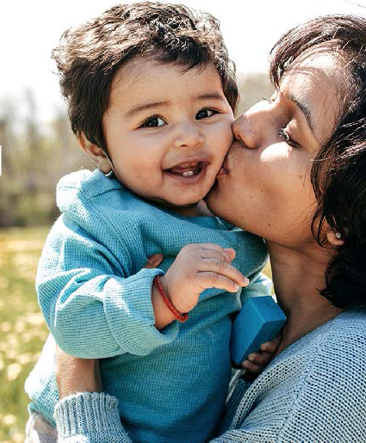
Parenting Under Stress: What Young Children Need to Thrive In Dangerous and Uncertain Times
Alicia F. Lieberman, PhD
University of California San Francisco

Slide 2
Wonder!
The joy of discovery
Discovering the world
Locomotion!
Words!
“I can do, therefore I am”
Discovering the other
Attachment: Secure base
Theory of Mind
Social expectations
Good and bad
Discovering the self
Exploring the body
Self-recognition
Naming feelings
Gender awareness

Slide 3
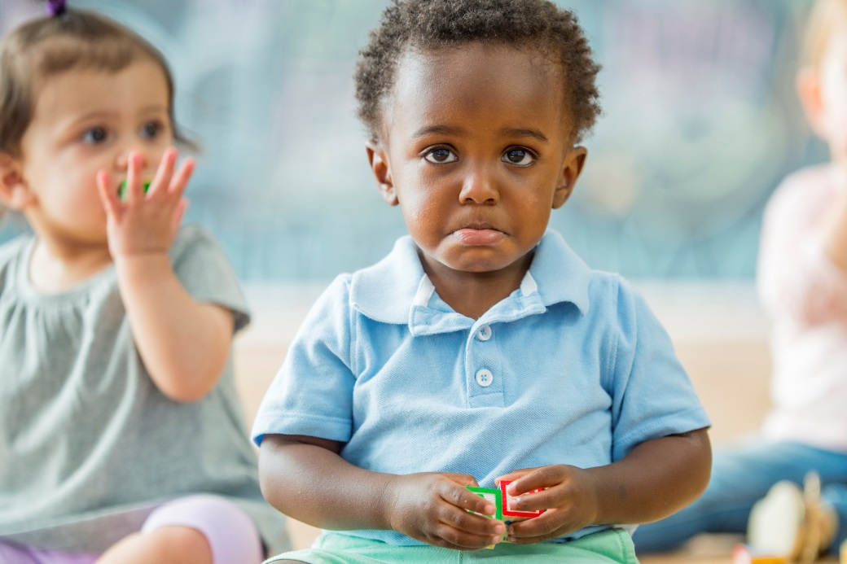
Normative Anxieties: Early Origins of Lifelong Internal Stress
Fear of separation
8-24 months
Fear of losing love
18-36 months
Fear of body damage
12-36 months
Fear of being bad: Origins of a moral conscience
36 months -5 years

Slide 4
Normative Parental Functions
Protection from danger
Caregiving
Socialization
Reality testing
Giving the child a sense that life is valuable and meaningful
Cultural differences in values and expectations
Each of these functions is vulnerable to stress and trauma

Slide 5
Reality Matters: Impact of Stress and Trauma
The first 3 years are the most dangerous in the child’s life:
Accidental injury
Interpersonal violence
Danger confirms anxiety:
“I will be left; I will be hurt; I can’t be loved; I am bad”
Fear is an adaptive response:
Freeze, fight, flight

Slide 6
COVID-19 and Sheltering-in-Place: Adjusting to New Stresses
Fear of known danger: Illness and death
Uncertainty generates anxiety:
What will happen if…?
Breakdown of the social contract
Heightened inequities
Low-income and minorities are disproportionately affected
Financial repercussions
From lower income to urgent need
Sheltering-In-Place:
Physical constraints
Increased expectations amidst higher need
No safety valve

Slide 7
Risk as a Continuum from Stress to Trauma: Where do COVID-19 and Sheltering in Place Belong?
Normative,
Developmentally Appropriate Stress
Situationally appropriate, Manageable-to-Dysregulated Stress
Traumatic Stress

Slide 8
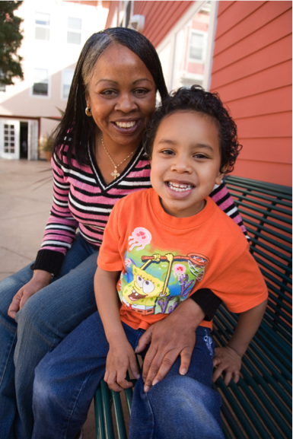
Mental Health Providers New Roles:
Trauma and Resiliency-informed Tele-health
Help protect children and caregivers from the physical and psychological health impacts of COVID-related stress
Telehealth sessions can foster therapeutic closeness
Show interest in immediate safety
Validate feelings as legitimate responses
Help move from dysregulated/traumatic stress to adaptive, manageable situational stress
Foster continued safety, developmental momentum, socialization goals
Photo by Lynnly Labovitz;
used with artist and patient permission

Slide 9
Creating A Secure Base: Pillars of a Therapeutic Attitude
Authentic connection over fear, protection and hope is the most important therapeutic intervention we can offer right now
Legitimizing fear as a primary motivation that fosters survival
Attachment: Protection and safety are the foundation of healthy love for children and adults
“Being with” in empathic problem solving with problems of living and emotional

Slide 10
Assessing Traumatic Experiences: Objective Danger And Coping Resources

Slide 11
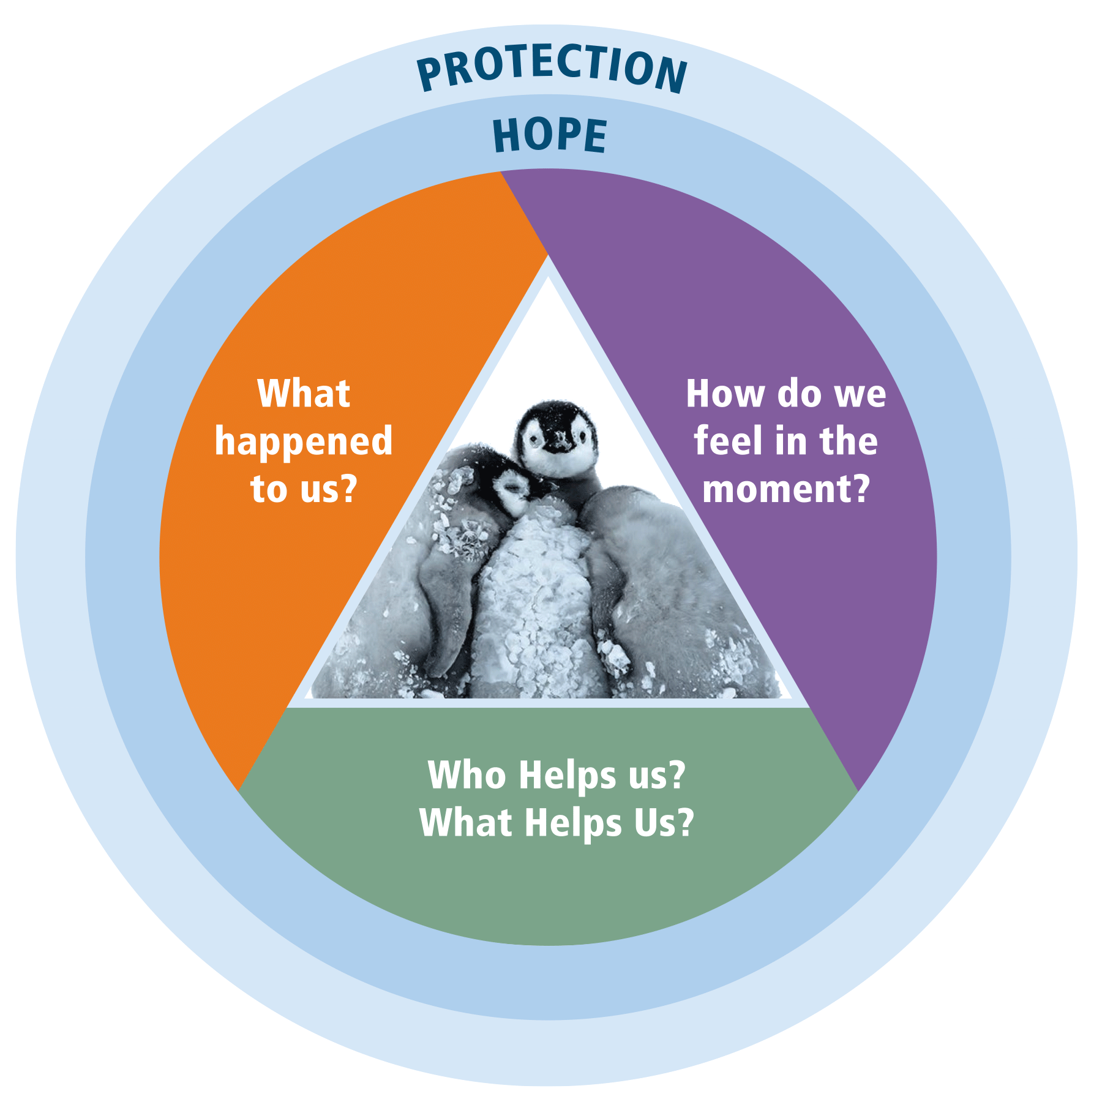
Linking Reality, Emotions, and Behavior: “The past is never dead. It’s not even past.”
- William Faulkner

Slide 12
Giving Meaning To Behavior
Developmental framework
Lens of normative themes and competencies
Lens of normative anxieties
Individual characteristics
Environmental framework
Cultural childrearing values and practices
Family relationships, attachment quality
Adversity/trauma vs. Protective resources
Historical experiences/Historical trauma

Slide 13
Changes In Parent-Child Relationship In the Context of Chronic Stress
Impaired affect regulation
New negative attributions
Changes to mental representations
Traumatic expectations
Parent and child may become traumatic reminders for one another

Slide 14
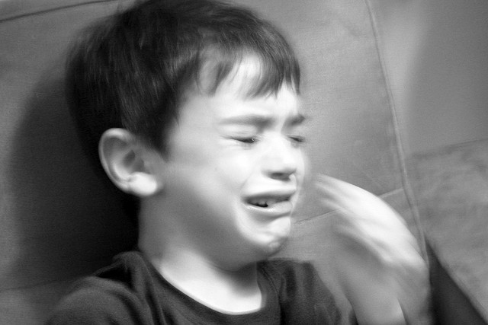
Young Children’s “Out Of Control” Behaviors May Be Signs Of Traumatic Stress
Notes:
Add tantrum photo

Slide 15
What Does Speaking the Unspeakable Mean?
Creating a safe, respectful space to address painful events that are consciously remembered and acknowledged as real by the child, caregiver, and others
Exploring possible causal connections between the painful event and presenting symptoms
Being attuned to the child’s and parent’s rhythm as they explore these links
Telehealth sessions offer a remarkably intimate glimpse into the family
Parent and child may show and reveal unexpected aspects of their lives

Slide 16
Building a Partnership
Translating the discrepancies in child’s and parents’ experiences
Keeping “what happened” in mind
Coping with incompatible agendas
Negotiating disagreements
Parent as supportive socializer

Slide 17
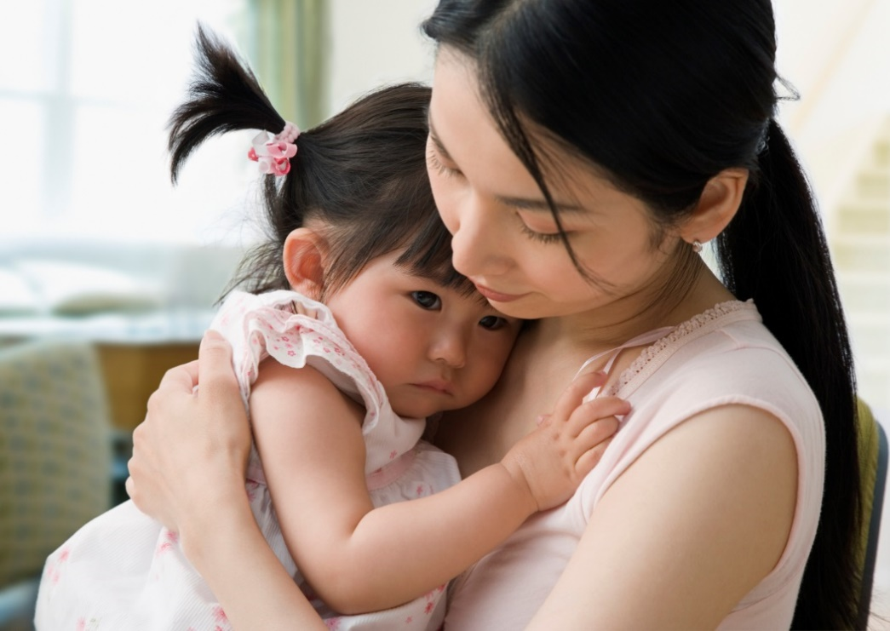
The Importance of Repair
From secure base to reciprocity: “What one person can do, another person cannot do”
When words are not enough
Making up after a fight

Slide 18
Caring for Ourselves
Chronic collective danger increases the risk of vicarious trauma and burnout
Essential to take small breaks to prevent the accumulation of stress
60-90 seconds may be suffice, repeated throughout the day
Notice the dysregulated feeling and give a name to it
Engage in a self-care activity that engages your kindness

