Slide 1
Meeting the health needs of children involved in the child welfare system through a model of integrated primary care
Jill McLeigh, PhD, Program Director
Rees-Jones Center for Foster Care Excellence
Children’s Health System of Texas

Slide 2
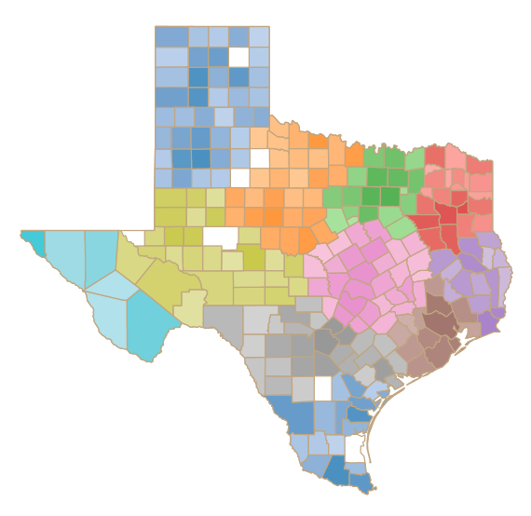
Texas Foster Care 2019
  49,525 children in DFPS conservatorship (includes PMC, kinship, other substitute care)
  29,242 children in foster care in TX on August 31st
    ~422,000 nationally
  Region 3: 10,368 children in foster care on August 31st
    4,297 children left foster care (or emancipated) in 2019
    Average months in care = 19
    Average number of placements = 2.3
  Source: DFPS Data Book, https://www.dfps.state.tx.us/About_DFPS/Data_Book/Child_Protective_Services/default.asp
Notes:
TX DFPS Conservatorship in 2018 = 52,397 (1.8% decrease in 2019)
Region 3: 6,505 in 2019 on August 31st

Slide 3
Key People in Foster Care
Child Protective Services (CPS)
  Investigations
  Family Based Support Services (FBSS)
  Conservatorship
    Considered guardian of child in care
    Medical consenters include caseworker, foster parent, kinship caregiver, child placing agency (case manager
  Foster to Adopt
  Kinship
  Local Permanency Specialists (formerly “ISEEYOU” workers)
Shelter placement
Court Appointed Special Advocate (CASA)
Guardian ad litem

Slide 4
Trauma and Foster Care
An estimated 90% of children in foster care have been exposed to trauma, with nearly half reporting exposure to 4 or more types of traumatic events (Stein et al., 2001)
A comprehensive review of children entering foster care in one state revealed that 1 in 4 exhibited trauma symptoms requiring treatment (Griffin, Kisiel, McClelland, Stolback, & Holzberg, 2012)
Trauma can be compounded by the removal of children from their families, loved ones, and communities and by adverse experiences in foster care.

Slide 5

Rees-Jones Center for Foster Care Excellence

Slide 6
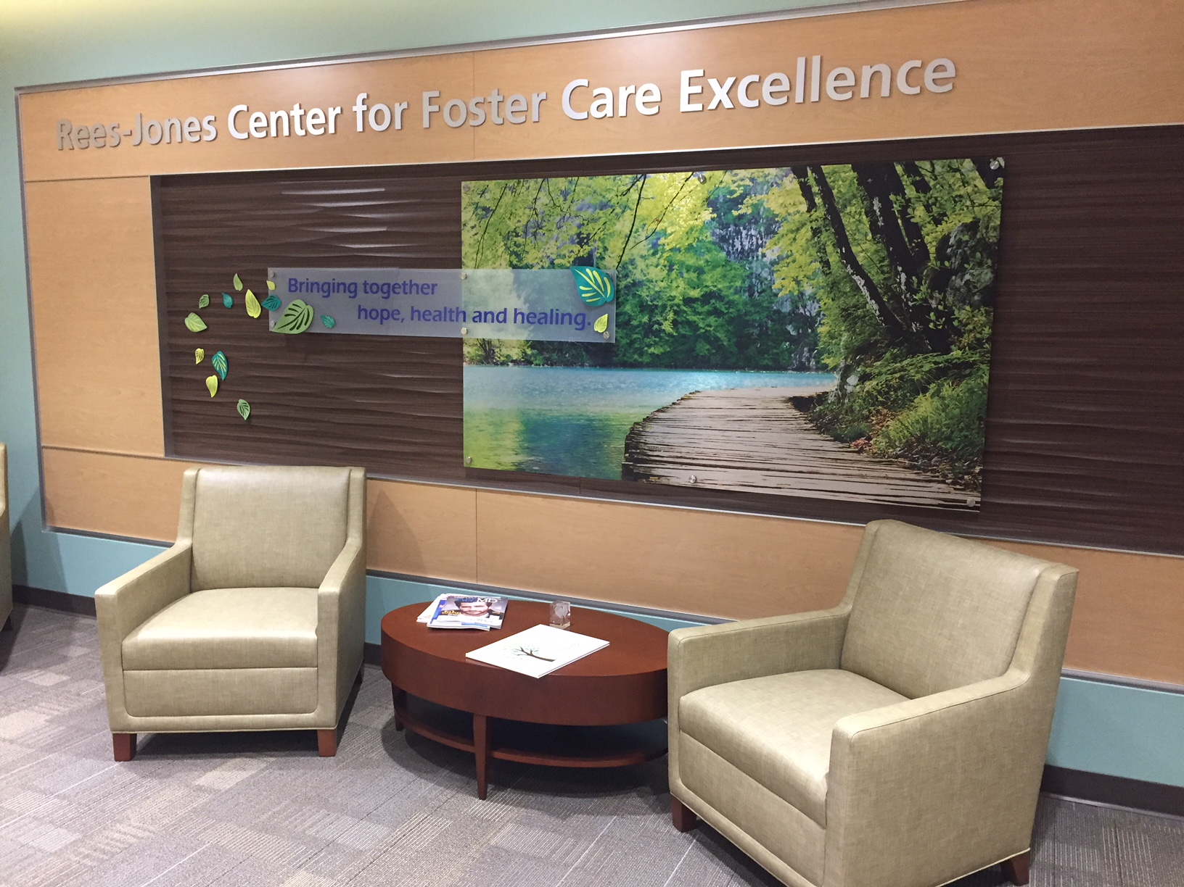
Rees-Jones Center for Foster Care Excellence
History
28+ year history of foster care clinic through ARCH & REACH at the Dallas campus
Dedicated Foster Care Clinic established in late 2000s → Rees-Jones Center for Foster Care Excellence in 2014
  Clinic locations in Dallas and Plano

Slide 7
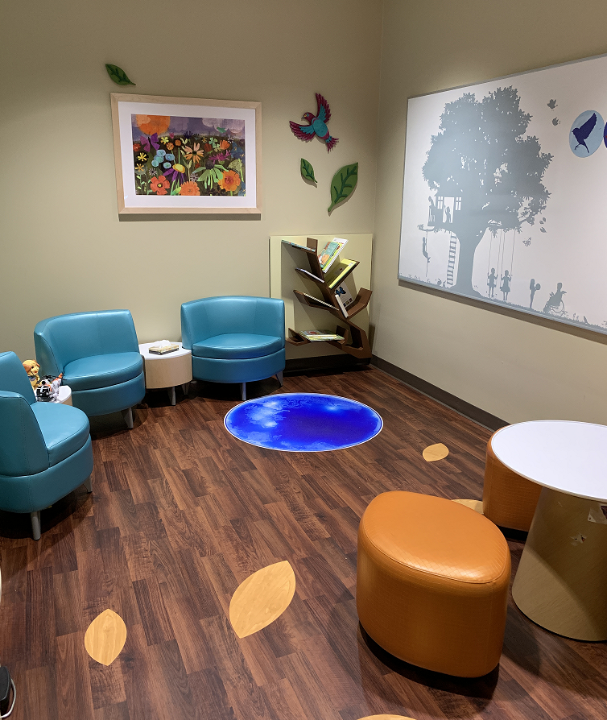
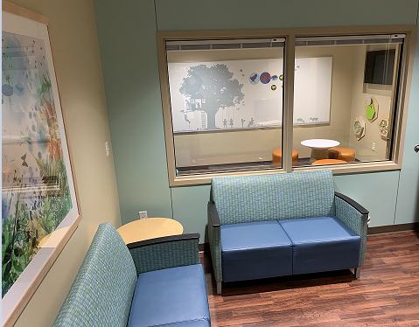
Rees-Jones Center for Foster Care Excellence
System-wide partnership between Children’s & UTSW
3 Branches
  Clinical
    Medical
    Mental health
    Developmental
  Academic/Research
    Trainees
    Research projects
    Research-to-Policy
  Community
    Advocacy/Policy
    Community relationships
    Consortium

Slide 8

Center Overview
~1,900 patients 2019
Medical home serving children upon entry into foster care through permanency
Modeled after the American Academy of Pediatrics – Healthy Foster Care America guidelines
No referrals required. Typically referred by Child Placing Agencies (CPA), Child Protective Services (CPS) or word-of-mouth
Notes:
Foster Care statistics (from DFPS databook): https://fosteringsuccessfoundation.org/resources/foster-care-statistics/

Slide 9

Primary Care Services
3 day examination
  DFPS requirement
Well Child Checks
Sick visits

Slide 10

Behavioral Health Services
Psychological and Developmental Assessment
Child & Adolescent Needs and Strengths (CANS)
Individual Therapy
  TF-CBT
  PCIT
  CBT
  Play Therapy
Parent Education
  Triple P Primary Care
  Developmental
  Behavioral
Groups
  Therapy
  Education (parent & child)

Slide 11
CPS Liaisons
Partnership with DFPS
Access to IMPACT
Gather trauma history, mental health assessments, and other documents
Liaise with caseworkers
Insider knowledge/perspective

Slide 12
Nurses and Nurse Coordinators
Triage sick calls
Help caregivers identify resources
Advocate for patients with MCO
PMN staffings
Obtain medical history
Run weekly huddles
Notes:
Esp. DME and in-home nursinf

Slide 13

How we do what we do…
Grant Funded
Insurance
  Medicaid carve out
  Reimbursement issues
    Services not covered
    Issues with EPIC (encounters, how billing goes out, etc.)
    Issues with two providers treating together at same time
    Hard to track reimbursements from mental health providers
Pay for Performance (P4P)
  Supplemental funds to support center based on treatment outcomes for children in care.

Slide 14
Lessons Learned
How to grow in an efficient and effective way
Oversight Committee = Accountability
Workgroup additions = improved efficiency of clinic
Clinical Flexibility
Dance with other providers
Different personalities
Sharing mental health ownership with another provider
Interplay between medical and mental health
Joint Treatment Planning
Notes:
Heidi (started 2015)
Efficient and Effective Growth:
1. Big picture into action – hard period during growth, inefficient system
2. Oversight (August 2017) created to oversee progress and work in program. Buy-in from hospital and medical center leadership.
3. Workgroups created (late 2017) to help involve staff into a more participatory model of care. (buy-in; empowerment; commitment)(NEED LIST OF WORKGROUP ACTIVITY)
*Requires a lot of communication and knowing each other’s expertise.
*Training doesn’t necessarily match the way we need to practice.
Clinical Flexibility
Dance with other providers
Dynamic different with different staff pairings
Allowing PCP’s to not need to worry about mental health concerns (compared to traditionally needing to triage care).
Medical care impacts mental health and vice versa.
Adenoid example
Joint Treatment planning
Sharing after visit summary section of EMR – cant be in the system at the same time updating
Sharing feedback with caregiver after visit so as not to overwhelm with A LOT of information/resources
Sharing information with relevant team members (referral to psychiatry for instance) or other care providers for child.

Slide 15
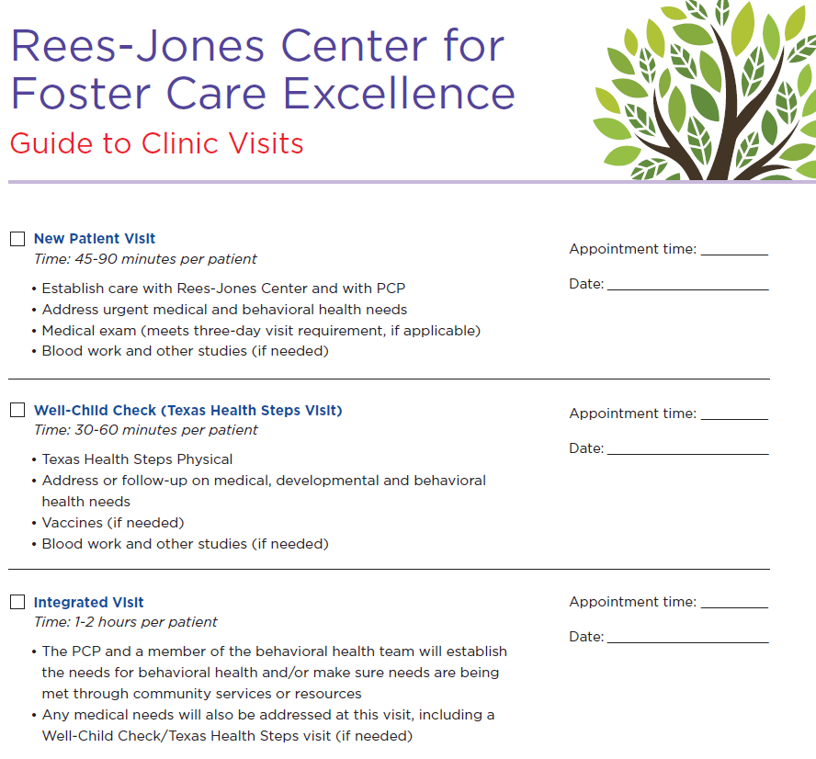

Slide 16
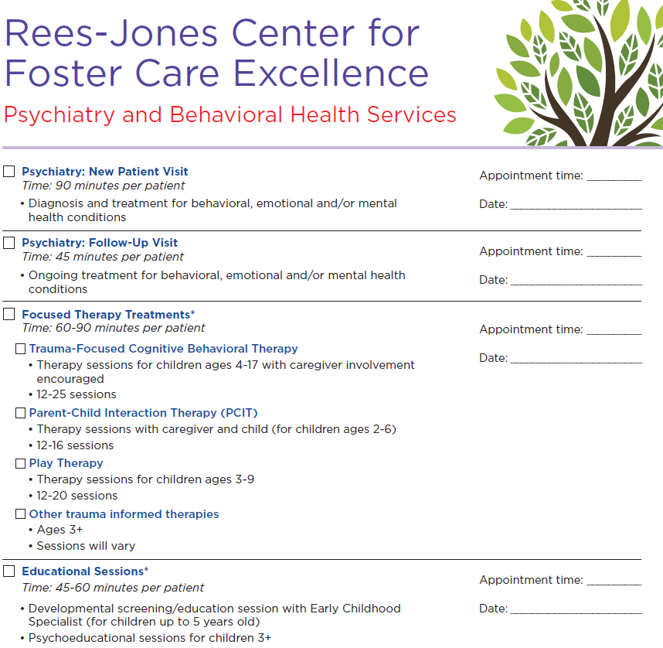

Slide 17
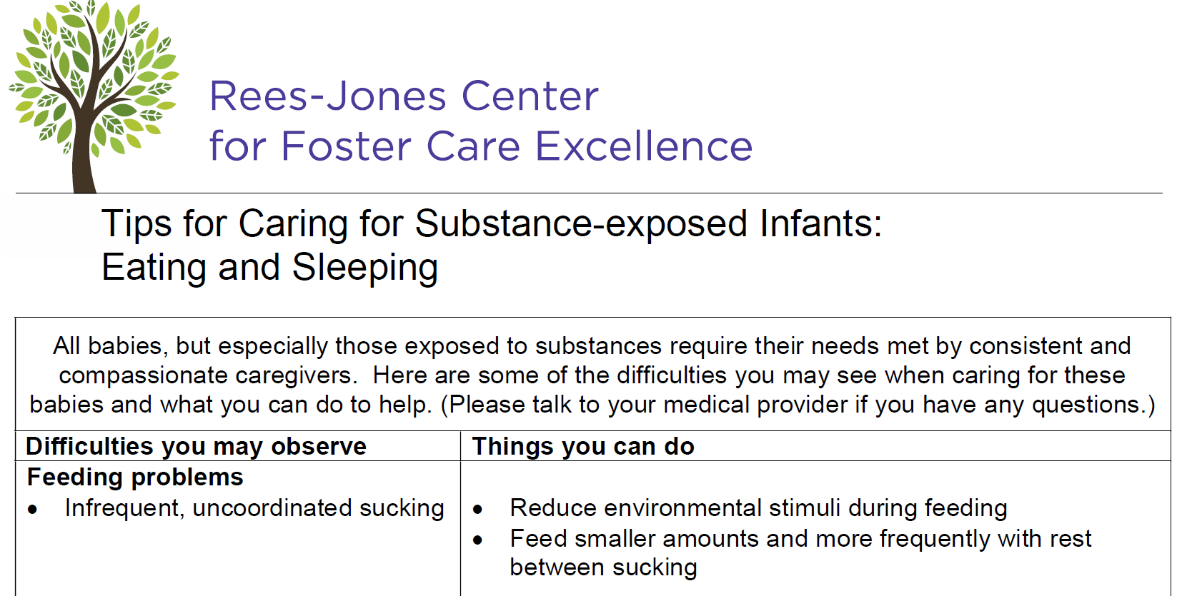

Slide 18

Why Trauma Informed Integrated Care?
  Enhanced access to services
  Improved quality of care
  Lower overall healthcare costs
  Improvements in mental and physical health
Barriers to Integrated Care
  Financial
    Billing doesn’t support integrated model with two providers working together
    Ex: 96150 = $16 reimbursement for Medicaid – code specific
  Organizational/Service System
    Inadequate billable time to adequately screen
    Lack of coordination of services that address core social needs
  Research
    Limited outcome data on integrated care needed to inform policy/reimbursement models
  Education and Training
    Limited trauma education and training opportunities for healthcare providers
National Child Traumatic Stress Network. (2018). Trauma Informed Integrated Care for Children and Families in Healthcare Settings. Retrieved from: https://www.nctsn.org/resources/trauma-informed-integrated-care-children-and-families-healthcare-settings

Slide 19
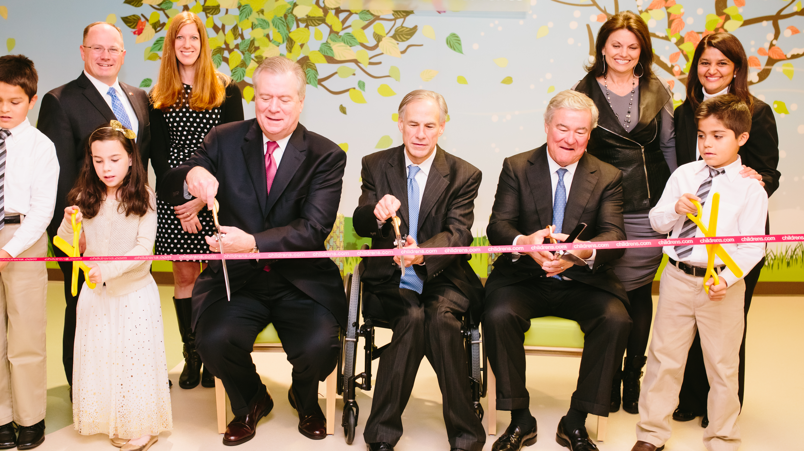
Legislative Activities
Activities:
Invited testimony for the House and Senate Health and Human Services Committees
Legislative guest site visits to the Center
Private meetings with legislators in Austin
2017 Efforts:
3-day medical exam
Sharing info b/w CPS and child’s primary care physician
2019 Efforts:
Trauma-informed care
Child abuse reporting
Extending insurance plan post-adoption
Notes:
Also, working with agencies:
Star Health: Higher reimbursement rates for evidence-based therapies
DFPS: PMN staffings

Slide 20







Partners
Rees-Jones Center
Family Advisory Council
Region 3 Foster Care Consortium
Notes:
Build on our expertise, but we recognize that there are a lot of needed expertise when it comes to foster care, and they aren’t all found w/n our 4 walls. When we develop policy priorities and in deciding what issues to “take on,” we look to broader communities.

Slide 21
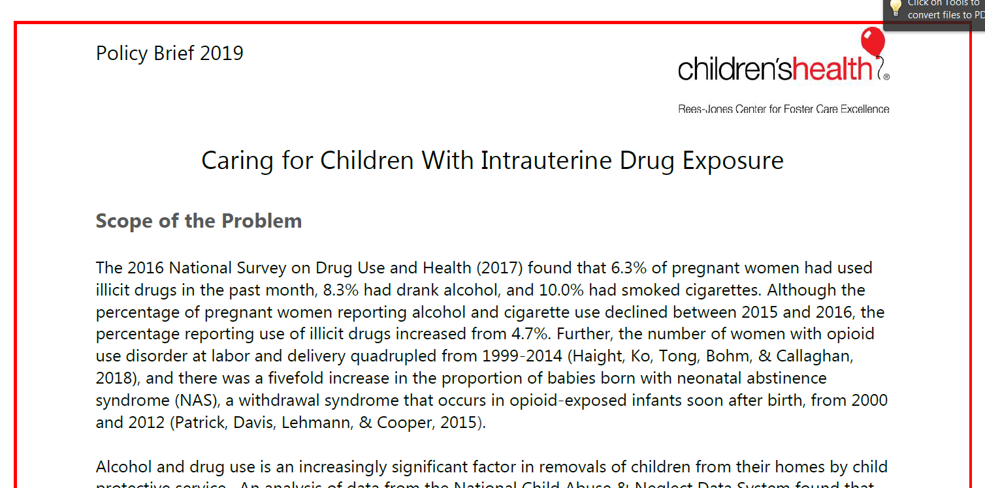

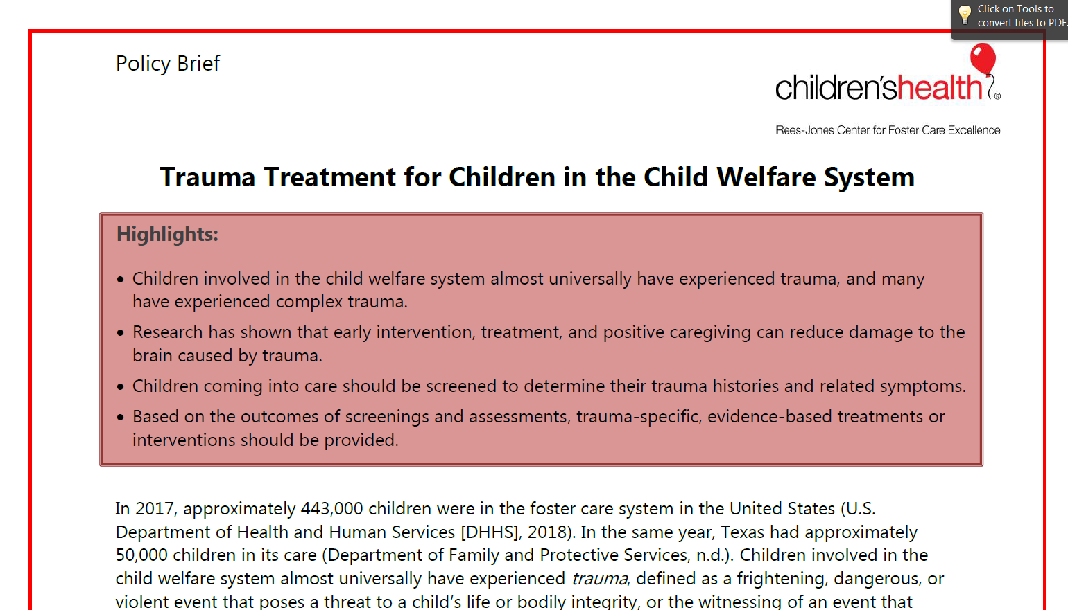
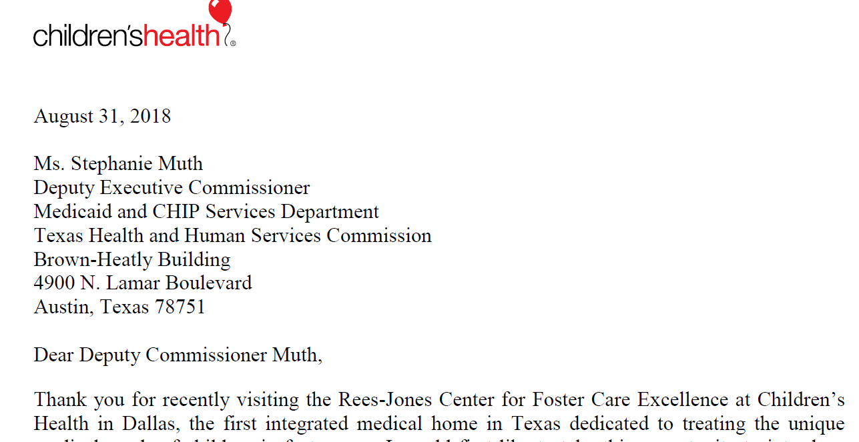
Notes:
Take the research, combine with experience, and put into policy brief

Slide 22

Research-to-Policy
Evaluating Pediatric Integrated Care
Contraception for Adolescents in Foster Care
Long-term Effects of In Utero Drug Exposure
Understanding Suicidal Behavior and Brief Assessment and Intervention in Primary Care for Children in the Child Welfare System

Slide 23
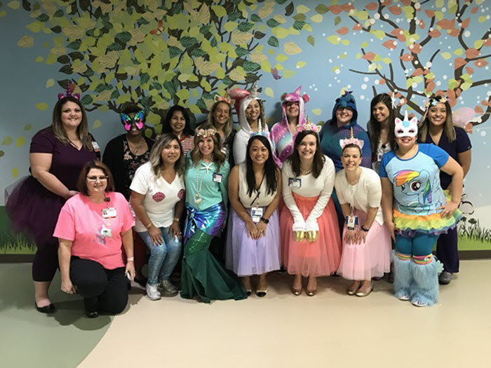
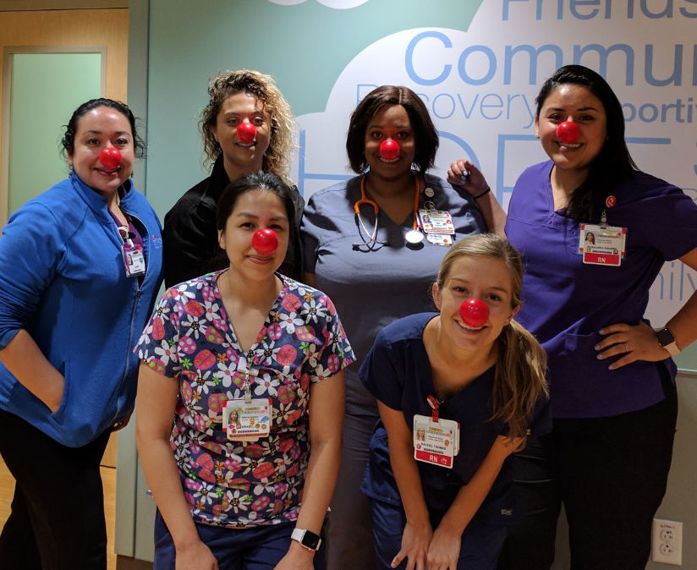
Questions?
                Thank you!
Jill McLeigh, PhD
Jill.McLeigh@childrens.com
Notes:
Add a Plano team picture

