Slide 1
Attachment Theory and Research: Clinical Implications
Miriam Steele
Department of Psychology
New School for Social Research
New York

Slide 2
Bowlby on persisting models
… it seems necessary to postulate that whatever representational models of attachment figures and of self an individual builds during his childhood and adolescence, tend to persist relatively unchanged into and throughout adult life. As a result he tends to assimilate any new person with whom he may form a bond, to an existing model and often continue to do so despite repeat evidence that the model is inappropriate. Similarly he expects to be perceived and treated by them in ways that would be appropriate to his self models and to continue with such expectations despite contrary evidence.

Slide 3
What can attachment theory and research bring to work with child maltreatment?
A model of affect regulation
A broad evidence-based knowledge of parents and children
A window upon the inner world (‘a move to the level of representation’ via ‘surprising the unconscious’)
A focus on resolution of trauma and loss
A high regard and respect for parents and children

Slide 4
Ainsworth’s Strange Situation
Activate the attachment system via separation
Activate the exploration system via novel playroom
Observe the child’s strategy upon reunion
Secure (65%)
Avoidant (20%)
Resistant (10%)
Disorganized (5-10% in non-clinical populations but up to 80% of maltreated infants)

Slide 5
Adult Attachment Interview (George, Kaplan & Main, 1985)
What happened?
5-adjectives for early relationship w/mother and w/father
Emotionally upset?
Physically hurt?
Separated? Rejected?
Abuse? Loss?
What do you make of it?
Why do you think your parents behaved the way they did?
Has childhood influenced the kind of person you are today?

Slide 6
Intergenerational patterns of attachment
Avoidant
Secure
Resistant
Disorganized
Dismissing (minimizing)
Autonomous (balanced and valuing)
Preoccupied (maximizing)
Unresolved re past loss or trauma (absorption in grief)

Slide 7
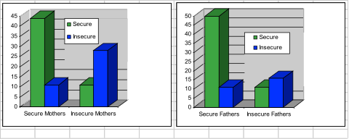
Prenatal classification of 96 mothers and 90 fathers on AAI by infant-mother (12 mos) & infant-father attachment (18 mos)
Steele, Steele & Fonagy, 1996, Child Development

Slide 8
Metacognition ---->
Reflective Functioning
an understanding of the nature of mental states
a relational perspective (mental states in one influence mental states in the other)
a developmental perspective re ‘the there and then’
an appreciation for demands of the current context, or ‘the here and now’
the reparation in the rupture and repair cycle
Notes:
jeremy holmes is related to arousal-only when feelings are held within manageable limits can one begin to think about them.

Slide 9
Indicators of past deprivation
Prolonged separation (>3mos) from parents before age 11
Single - parent family
Low SES
Paternal unemployment > 3 months
Severe illness in mother or father
Boarding school experience before age 11

Slide 10
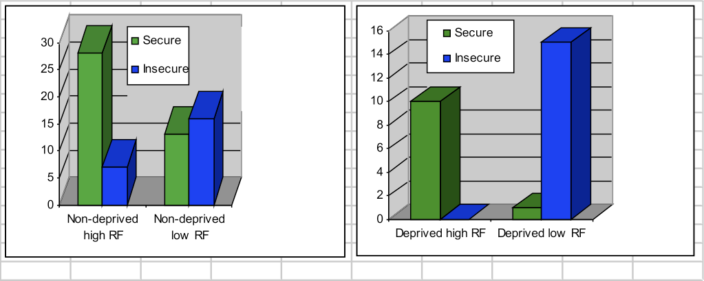
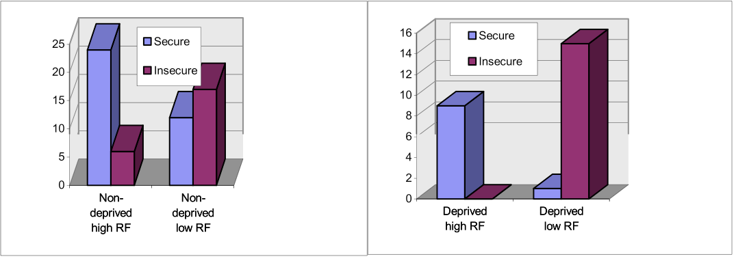
Frequency of secure and insecure infant-mother classifications grouped by mothers’ past experiences of deprivation and present reflective-functioning (Fonagy, Steele, Steele, Higgitt & Target, 1994, Emmanuel Miller Lecture, Journal of Child Psychology & Psychiatry).

Slide 11
Attachment Representations and Adoption Study
Miriam Steele Jeanne Kaniuk Jill Hodges

Slide 12
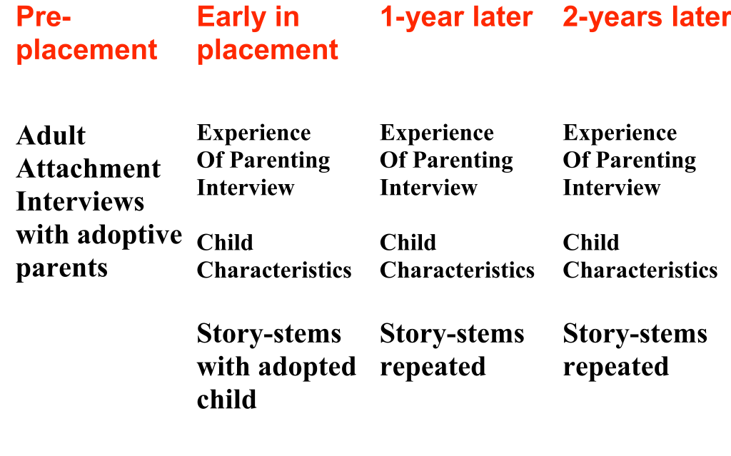
Attachment representations in adoptive families (AFC/GOS/Coram Family Adoption Service) N=65 late-adopted children N=43 early adopted

Slide 13
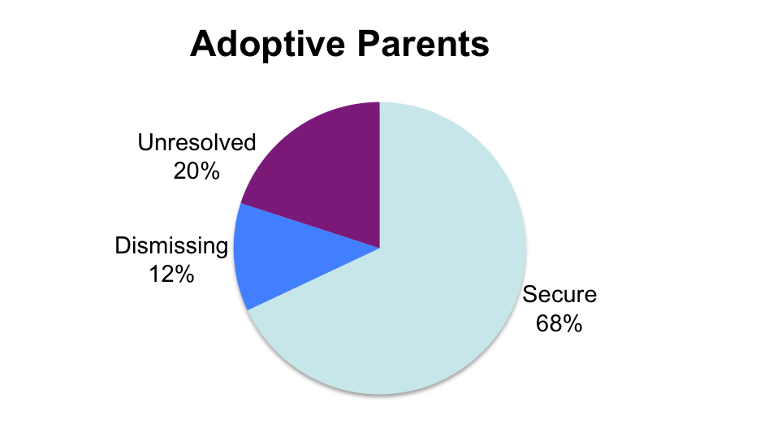
Adult Attachment Interview Distributions
(Steele et al, 2008)
(Van Ijzendoorn & Bakermans-Kranenburg 2008 (N=1012)

Slide 14
Pre-placement characteristics and adopters’ attachment status: Implicit knowledge of the social worker?
Mothers with autonomous-secure interviews were more likely to be have children placed:
who were abused at a younger age
had a higher incidence of physical abuse

Slide 15
Parent Development Interview modified after Aber, Slade, et al 1985
View of the child
- thumbnail sketch of what child is like?
-what was child like when first placed?
View of relationship
-5 adjectives to describe child
-time last week you did/did not really click
Self as parent
-most joy, most pain in being a parent
-where do you turn for emotional support
Child’s adaptation to placement
-how affectionate, over-friendly, response to distress

Slide 16
Coding of Parent Development Interview (Henderson, Hillman & Steele, 2003)
Mother’s representation of self
- joy, anger, disappointment/despair, hostility
- competence, confidence, need for support, level of child focus, knowledge of attachment
Mother’s representation of the child
-happy, angry, shows affection, is rejecting, is controlling/manipulative, is over-friendly, is creative in play, is frustrated with engagement
Narrative style of mother
-richness of perceptions, vivid description, reflective ability, overall coherence

Slide 17
Joanne when asked “Can you describe a time in the last week when you really clicked with Sam?”
We were gardening yesterday, and I found this big, fat green bug, in the soil and brought it over for him to see it, and he really liked it. And he likes wood lice, which I can’t stand, and he said ‘Feel it on your hand Mummy, it’s all tickly’. And so I let him put a wood lice on my hand, which was against my better judgment, and he really liked the fact that it was running all over me.

Slide 18
Julia when asked “What do you like most about Tom?”
Tom is a little charmer. You know, I mean when people look at him, you know, they see what appears to be a happy little child. He’s far from being a happy little child. He needs statementing. The previous borough got out of that. Hopefully the borough that we’re in, will do that for him. But just say, you know, the worst scenario and, you know, he didn’t do very well at school and that, he could probably get by in life because of his charm. Once he got to the stage where he could use it to his own good, whereas at the moment he’s not able to reason or anything like that.

Slide 19
Mothers rated as autonomous-secure (vs insecure) and their responses to Experience of Parenting Interview at placement:
More:
-joy, competence, child focus, reflection on relationship, richness, and vividness of description
Less:
-anger, despair

Slide 20
Mothers rated as autonomous-secure (vs insecure) and their responses to Experience of Parenting Interview at one-year follow-up :
More:
guilt, child is rejecting
But also more:
child focus, richness, confidence

Slide 21
Mother’s rated as autonomous-secure with regard to attachment when interviewed about their experience of parenting at two year follow-up:
Less:
guilt
More:
joy, competence, confidence
knowledge of attachment, reflection on relationship, and richness of perception
coherence: secure (n=42) group mean=3.4, sd=.96
and insecure (n=13) group mean=2.3, sd=.66,
t=4.8, df=1,53,(p < .0001)

Slide 22
Mothers rated as Unresolved with regard to Loss/Trauma when interviewed about their Experience of Parenting at placement:
More:
-need for emotional support, disappointment/despair, hostility
Less:
-joy, competence, confidence, level of child focus, knowledge of attachment, reflection on relationship, coherence, richness of perceptions

Slide 23
Parent Development Interview responses in relation to number of caregivers in child’s history
Those with more caregivers prior to placement:
were reported by their mothers to have higher levels of aggression, more controlling behavior, are less affectionate and more rejecting
Mothers report higher levels/degrees of anger, greater needs for emotional support, lower confidence, & lower degrees of warmth
One year on: more caregivers are associated with more aggression and frustration in the children
Two years later: children with more caregivers do not show differences

Slide 24
Correlations between child’s age and Experience of Parenthood Interview (PDI) at placement
For full late-adopted sample, if child was older at placement, mother is more disappointed, child is less happy, & less affectionate
For ‘insecure’ mothers, if child was older M is more angry, less warm and child is thought to be less affectionate
For ‘secure’ mothers, child’s age at placement was unrelated to mother’s experience of parenting

Slide 25
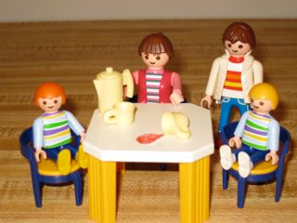
Story-stems used to elicit children’s emotion narratives
MacArthur Network (Emde, Bretherton, Oppenheim, 2004)
Children presented routine conflict dilemmas, then are asked to
“show me and tell me what happens next?”
MacArthur Spilled Juice
Narratives are coded for
content and process

Slide 26
4 internally consistent sets of themes were identified, at each time point in each sample through data reduction of the ratings made of over 3000 story-completions
Security Child Seeks Help, Siblings/Peers Helping, Realistic Mastery, Adult Provides Comfort, Adult Provides Help, Adult Affectionate, Limit Setting, Coherent Aggression, Acknowledge Distress of Child and Adult, Domestic Life
Intense aggression Child Endangered, Child Injured/Dead, Excessive Compliance, Adult Unaware, Adult Actively Rejects, Adult Injured/Dead, Extreme Aggression, Neutralisation, Throwing Away/Out
Disorganized/controlling Child Parents/Controls, Catastrophic Fantasy, Bizarre/Atypical Material, Bad to Good Shifts, Magic Omnipotence
Defensive avoidance No Engagement, Disengagement, Initial Aversion, No Closure, Premature Foreclosure, Changes Constraints, Avoidance of Conflict, Denial of Distress

Slide 27
Story completion themes in the late adopted group over first 2 years of placement: Year Group Effect
(Wilks Lamda=.80, F=9.35, df=8,63, p < .001)

Slide 28
Defensive avoidance themes of maltreated children as a function of adoptive mothers’ AAI insecurity versus security AAI status (Roy’s Largest Root F=3.29 (4,138) p < .005)
Year group by Maternal AAI interaction, F=4.32, p < .05
Notes:
Maternal AAI by year group interaction.

Slide 29
Defensive avoidance themes of maltreated children as a function of adoptive mothers’ unresolved versus resolved AAI status
Year group by Unresolved AAI interaction, ANOVA F=3.48 (df 2, 168) p < .05
Notes:
The MANOVA result investigating year group by resolved versus unresovled status of adoptive mothers’ AAIs also revealed this somewhat peculiar effect of initially high defensive avoidance scores in the children of resolved mothers, who by year 2 follow-up are the least avoidant.

Slide 30
Did collecting Adult Attachment Interviews from the adoptive fathers, as well as the mothers, provide added value?

Slide 31
Children’s summary ‘insecure aggression’ and ‘disorganization’ scores grouped by interaction of parents’ AAI security
(Roy’s Largest Root F=4.19 (4,137) p < .005)
Notes:
Note that THIS IS NOT A YEAR GROUP effect: The influence of both parents’ AAIs is evident early in placement, and becomes consolidated over time. When NEITHER adoptive parent was secure, children score significantly
higher on disorganization and insecure aggression (Bonferroni pairwise tests)

Slide 32
On the persistence of old models
Why do the ‘secure’ themes increase for all children but aggressive and disorganized themes remain stable over time for children placed with two insecure caregivers?
“New models of self with others built up in treatment do not obliterate old models. They are build up alongside the old: the potential activation of the old remains: particularly under conditions of stress” (Anne Hurry, 1998, pg. 51)

Slide 33
Mary Main (1990) comments that “at times of distress the secure infant has only one consideration in mind, how to alert the parent for proximity. The insecure infant in contrast, has to also consider the parent’s response.”
Tronick (1997; pg.65) hypothesises “that reparation of interactive errors is the critical process of normal interaction that is related to developmental outcome rather than synchrony or positive affect per se.”
Bowlby’s earliest writings on affect regulation and specifically on the ambivalence that must exist in every parent, asserts that insecure parents find the child’s negative emotions, especially hatred directed towards the parent, the most difficult and meet such displays with a similar matched negative response, an averted gaze, withdrawal or display of concomitant anger (Bowlby, 1956/1979).
How much more so are these comments on parenting must be relevant to the caregiver of the child in placement ….

Slide 34
