Slide 1
Status of Native Women
Pre-Colonization to Present
Molly Bryant (Cherokee) & Harmony Revard Fuller (Osage)

Slide 2
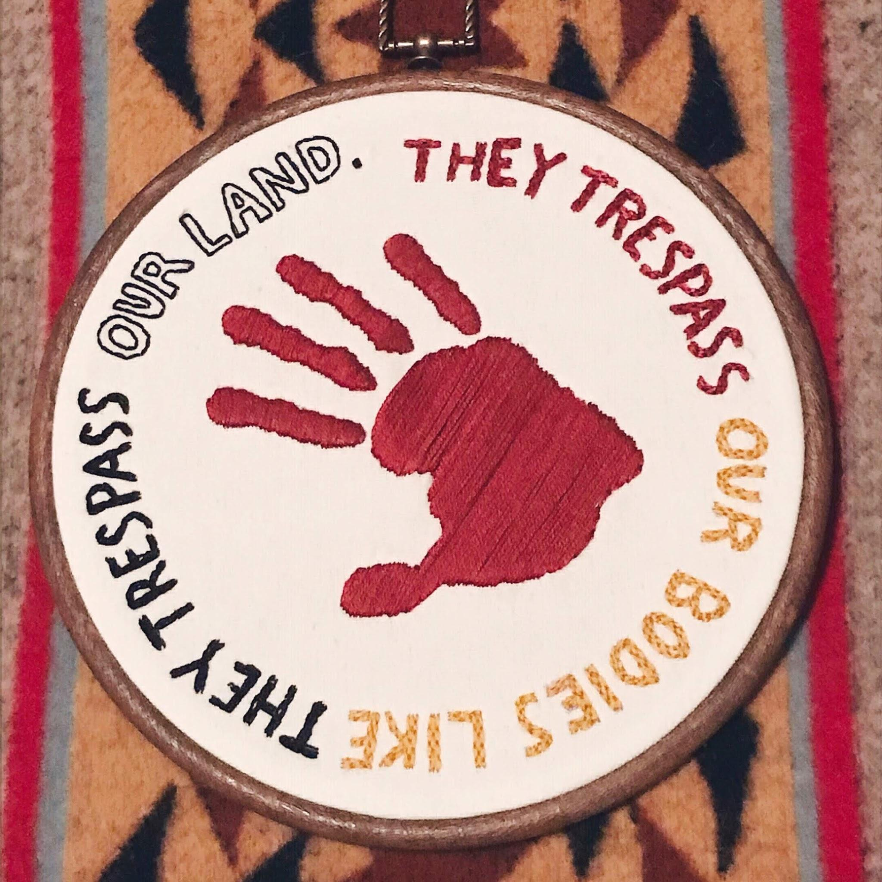
Agenda
Prevalence of sexual violence
Traditional orientation to women
Policies past and present
Current status and positive movements

Slide 3
4 in 5
Native Americans will be raped, stalked, or abused in their lifetime
(Malcoe & Duran, 2004)
Notes:
Take statistics with a grain of salt, they are not an exact science and they tell part of the story but not the full story. Numbers are most likely much higher due to ways of collecting data (mostly through the federal government or police reports) but these numbers/stats are already staggering.

Slide 4
10 times
Indigenous women face murder rates that are
the national average
(National Indigenous Women’s Resource Center, 2016)
Notes:
Missing and Murdered Indigenous Women and People

Slide 5
1 in 3
Native women will be raped in the lifetime
(Futures Without Violence, n.d.).

Slide 6
9 of 10
of those perpetrators of rape against Native women are Non-native
(Malcoe & Duran, 2004)
c
Notes:
9 of 10! We will discuss how this happened throughout the presentation, but you need to know that Indian Country has become - and in some ways always has been - a hunting ground for perpetrators of sexual violence against Native women. From the moment Christopher Columbus stepped foot on this continent until now, Native women have been used by European men as tools of war and have been violated with little accountability for their actions.

Slide 7
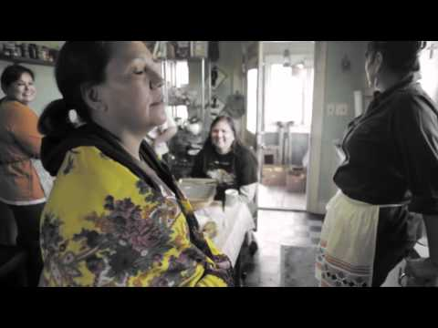
To the Indigenous Woman by the Ryan Red Corn (Osage)
Notes:
This video is about 5 mins. It is a poem written by Ryan Red Corn from the Osage Nation. It is a high-impact poem, deeply moving and powerful, so please listen intently, feel those feelings of anger and sadness if you are in a place that you can. Don’t forget to take deep breaths too.

Slide 8
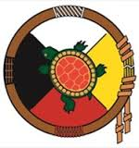
Traditional Tribal Orientations to Women
Matrilineal descent
Southeastern tribes like Cherokee, Chickasaw, and Muskogee (Creek)
Iroquois, Hopi, Navajo, Osage (matrilocal), etc.
Not gender-neutral but complementary and balanced
Gendered roles with horizontal power instead of hierarchy
Not devoid of oppression or injustice (personal vs. systemic)
Women owned property, made decisions for the tribe or clan, chose tribal leaders, etc
Native women were builders, warriors, farmers, and made political decisions
Notes:
Matrilineal: children belonged to mother’s clan, power to name/remove leaders of the clan,
Matrilocal: husband goes to live with wife’s family or near them
Not gender-neutral: sometimes described as nonbinary complimentary, as sometimes men would perform women’s duties or the other way around, gender roles weren’t a fixed at they are now in many culture, and there were some tribal cultures that had more than two genders
Gender roles: men hunt, women childcare and cook (but not always!) - no difference in value placed on those roles, held same power because both were necessary to keep the community running

Slide 9
Traditional Tribal Orientations to Women
Pre-Colonial Responses to Rape
Gendered violence rates much lower (some claim non-existent)
Victim-centered judicial systems
Lakota Culture: The woman owned her body and all the rights that went with it
Iroquois and Dakota cultures: A man could not be elected to a leadership position if he had ever raped a woman
Notes:
Victim-Centered judicial systems: victims were provided with spiritual and material goods, often choosing what they wanted as the form of accountability - and men were held accountable by losing positions within the tribe

Slide 10
Traditional Tribal Orientations to Women
Pre-Colonial Responses to Rape (Continued)
Mvskoke 35th Law: And it be farther enacted if any person or persons should undertake to force a woman and did it by force, it shall be left to woman what punishment she should satisfied with to whip or pay what she say it be law.
And then the colonists arrived . . .
Notes:
There are several things we could pull out of this law that would be so confusing to many prosecutors or even sexual assault advocates today. But to me, one of the most important aspects is the phrase “what she saw it be law.” This phrase gives the victim/survivor the legal right to fully participate in the legal process of punishment against the perpetrator. She gets the power back in this situation. For most of US/Anglo-American history, rape was viewed a “property crime” perpetrator against a MAN - either the father of the woman or the husband of the woman, never the woman herself. Furthermore, in those systems, rape required two eyewitnesses, a woman’s testimony wasn’t sufficient. Additionally, the concept of marital rape wasn’t even in existence in US law until the 1990s! Oklahoma was the second to last state to outlaw and we’ve still got some loopholes to work on. These US laws and cultural ideas of rape all vastly different than Mvskoke law and many other tribal laws at the time that acknowledge and honored women as fully-human, trustworthy, and fully capable of making decisions for themselves.
Colonists used rape as a tactic of war. In fact historical documents showed that the ironically named Puritans were “amazed at the sexual restraint of Indian men who never raped their captives” and George Croghan, a US navy captain in the late 1700’s testified that “I have known more than onest thire Councils, order men to be put to Death for committing rapes, which is a crime they despise.”

Slide 11
“Change can occur only when colonisation is brought ‘front and centre and named as the root cause’ of Indigenous overrepresentation.”
-Chris Cunneen & Simone Rowe, Australian criminologists

Slide 12
The inherent power of a government to address and respond to its own internal and external affairs.
THE RIGHT TO SELF-RULE
Notes:
Sovereignty in this context, is tribal sovereignty, which refers to the right of American Indians and Alaska Natives to govern themselves - this gives them authority over territory, people, and relevant subject matters. The U.S. Constitution recognizes Indian tribes as distinct governments and they have “the same powers as federal and state governments to regulate their internal affairs” I put this in “quotes” because since the inception of the United States and the idea of “allowing” tribes to have sovereignty, there have been countless laws and policies that have stripped tribes of their sovereignty - it continues through our current times with Oklahoma state Governor Stitt his push to end tribal contracts for gaming.

Slide 13
Major Crimes Act (1885)
Response to 1883 US Supreme Court ruling Ex Parte Crow Dog
Imposed federal justice system on tribal communities
Gave unilateral prosecutorial framework over tribes
Federal government gained control over criminal cases on reservations
Led to “concurrent” jurisdiction for tribes and US gov’t over criminal cases
Instead of rape being handled within a community based on the beliefs and traditions of the community, rape became domain of federal government
“A rape survivor [in Indian Country] who reports the crime will necessarily interact with federal representatives carrying the official badges of colonization [i.e., FBI, BIA].” Sarah Deer
Notes:
August 5, 1881 Crow Dog shot and killed Spotted Tail who was the uncle of Oglala Lakota war Leader, Crazy Horse. The Lakota Sioux Tribe ordered Crow Dog to pay restitution to Spotted Tail’s family in a tribal setting, imposing traditional penalties. Since Spotted Tail had a relationship with the BIA word spread and the Federal government brought murder charges on Crow Dog, despite having already been tried by Lakota Sioux. Crow Dog was sentenced to death but petitioned a writ of habeas corpus stating that the Federal government did not have jurisdiction over Native on Native crime in Indian country. The writ of habeas corpus was issued and Crow Dog was released! Crow Dog actually beat the US government in his case. Shocked and embarrassed by the outcome and under great pressure from the BIA and non-Native people, Congress passed the Major Crimes Act of 1885 gaining control over criminal cases on reservation territory.

Slide 14
Oliphant v. Suquamish
(1978) US Supreme Court
Tribal nations lost all criminal jurisdiction over non-Natives
Essential impunity for non-Natives in Indian Country
Tribal police may arrest a non-Indian only if cross-deputized with local or state law enforcement
Federal government has extremely low rates of rape prosecution
Very selective of cases
Geographical, language, cultural barriers
Length of time for sentencing
Tribes feared that reservation communities are at a greater risk of lawlessness
Criminal activity increased due to a belief that L.E. is less comprehensive
Notes:
In 1973, Mark Oliphant (non-Native) was arrested and charged with assaulting a LEO and resisting arrest during the annual Suquamish Tribal celebrations. He argued that the tribe had no jurisdiction over him as a non-Native. The US Supreme Court rejected tribal lawyers’ argument that Congress or treaties are the only way the federal government could take away tribal jurisdictional powers. Citing a series of laws excluding non-Native from tribal laws and jurisdiction, the majority of the Supreme Court concluded that tribal courts do not have jurisdiction over non-Natives.
What does this mean? If a non-Native rapes a Native woman, the tribe has absolutely no criminal jurisdiction over the non-Native and cannot punish the crime. If the LEO is cross deputized with state or federal LE, then they can arrest but not prosecute. This is still the law today. It is 2020.

Slide 15
Violence Against Women Act Reauthorization (2013)
The original Violence Against Women Act 1994 signed into federal law by President Bill Clinton providing $1.6 Billion toward the investigation and prosecution of violent crimes against women.
In 2013, President Obama signed the Reauthorization of VAWA providing more clarification on civil authority for tribal courts
Section 904: Tribal Jurisdiction over Crimes of Domestic Violence
Section 905: Tribal Protection Orders
Notes:
Violence Against Women Act 2013 (VAWA) that created a framework for tribal governments to prosecute non-Indians for the first time since Oliphant v. Suquamish.
Currently tribes can prosecute non-Indians only for domestic violence, dating violence, and criminal violations of protection orders.

Slide 16
VAWA Section 904: Tribal Jurisdiction over Crimes of Domestic Violence
Section 904: Tribal Jurisdiction over Crimes of Domestic Violence amends pieces of the Indian Civil Rights Act (IRCA) of 1968
Authorizes tribes to exercise “special domestic violence jurisdiction” over non-Indians for:
Acts of domestic violence or dating violence that occur in the Indian country of the participating tribe
Violations of Protective Orders that are violated in Indian country of participating tribe
Tribes are not obligated to exercise special domestic violence criminal jurisdiction.
(U.S. Department of Justice, 2013)

Slide 17
What VAWA 2013 Section 904 Does Not Cover
If the victim and defendant are both non-Native
If the Non-Native defendant lacks sufficient ties to the tribe*
If the crime did not occur in the Indian country of participating tribe
If the tribe chooses not to execute VAWA 2013 Section 904 jurisdiction
* Defendant must either:
Reside in Indian country of participating tribe
Be employed in Indian country of participating tribe
Be a spouse, intimate partner, or dating partner of a tribal member, or an Indian who resides in the Indian country of participating tribe

Slide 18
VAWA Reauthorization (2013)
Who is excluded?
What is excluded?
(U.S. Department of Justice, 2013)
Notes:
Who is excluded? (Acquaintances, strangers, other family members)
What is excluded? Any sexual violence that is not domestic violence (does not included sexual assault, stalking, sex trafficking, child abuse)

Slide 19
VAWA Reauthorization (2019)
What would it do?
Close boyfriend loophole
Expand protections for transgender survivors of DV
Expand tribal jurisdiction over Non-natives
Why has it stalled?
The boyfriend loophole and the NRA
Notes:
What would it do?
Close The Boyfriend Loophole: Among other things, the new-and-improved version closed the infamous "boyfriend loophole," which excludes people convicted of stalking or abusing a non-spouse partner from the scope of laws that limit an abuser's ability to obtain firearms. (Existing law covers a narrower set of relationships, such as those in which the abuser lived with or had a child with the victim.)
Strengthened provisions of the VAWA related to transgender survivors of domestic violence.
Expanding tribal jurisdiction over non-Native perpetrators to include crimes of sexual assault, sex trafficking, stalking, child abuse, and assaults against law enforcement
Expand access to federal criminal databases for tribes
Create a protocol for responding to missing persons cases (MMIW)
Create a pilot program to address the very unique needs of Alaska Native
Why has it stalled?
The National Rifle Association, warned House Republicans that voting for the House bill would negatively affect their NRA ratings and NRA spokesperson told reporters that this new VAWA bill was "a smokescreen for its real goal—banning firearms ownership."
Back and forth bills, very partisan now - one is Democrat, the Republic one has left The Boyfriend Loophole also eliminates provisions intended to address the crisis around missing and murdered Indigenous women
Both parties are blaming each other, who loses? Native people.
VAWA funding continues for grants, but any updates to the bill are at an impasse
Lankford - issues with expansion of tribal jurisdiction in particular, Inhofe will not reply, Hern has issues with everything

Slide 20
“Today’s mainstream feminist theories about rape are often responding to a culture grounded in a patriarchy of European origin. When tribal governments respond to gendered violence, though, they are responding to a phenomenon fully entrenched in abusive colonial power”
-Sarah Deer, MacArthur Genius & Professor of Law

Slide 21
Current Status of Indigenous Women
Native women’s power comes not just politically, but also educationally, artistically, economically, and through ritual practices.
Native women still face strenuous challenges with data suggesting that Native women’s health and mental status is significantly worse that non-Native women, living under multiple oppressions (intersectionality)
Gender
Risk of Poverty
Race/ethnicity
Sexual orientation
(Medicine, 2001),
Notes:
Sovereign Bodies Institute led by Native women began documenting Missing and Murdered Indigenous Women/People on their own since the US government would not do it (political/educational), artists like Joy Harjo (Muscogee) who is the Poet Laureate of the US for two years in a row and is making waves in the literary world (artists), Mary Katherine Nagle (Cherokee) lawyer and playwright and others using artistic expression to raise awareness of Native women’s issues in particular (legal/artists), Casey Camp Horinek (Pawnee) environmentalist

Slide 22
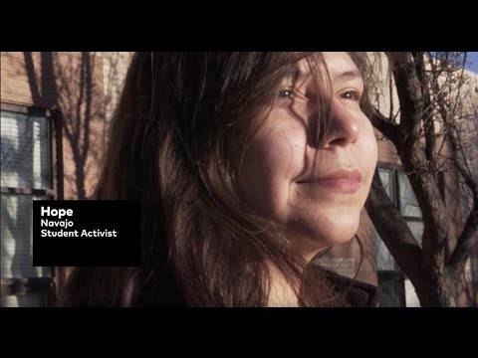
Current Status of Indigenous Women
Video: Native Girls Rise

Slide 23
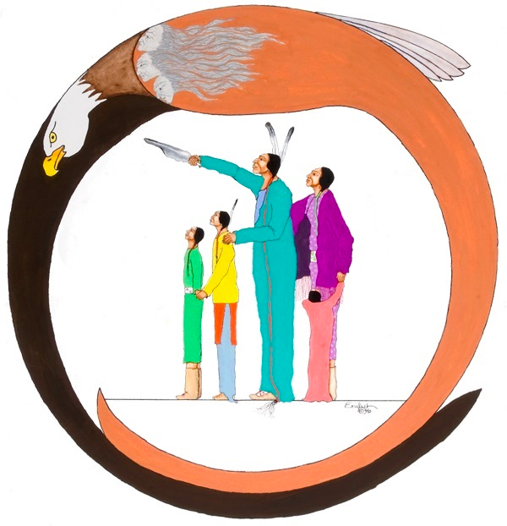
Positive Movements
Native Alliance Against Violence (oknaav.org)
Sovereign Bodies Institute (sovereign-bodies.org)
National Indigenous Women’s Resource Center (NIWRC.org)
Mending the Sacred Hoop (mshoop.org)
Tribal Law and Policy Institute (TLPI.org)
Indian Law Resource Center (indianlaw.org)
NOISE (Northeast Oklahoma Indigenous Safety and Education)

Slide 24
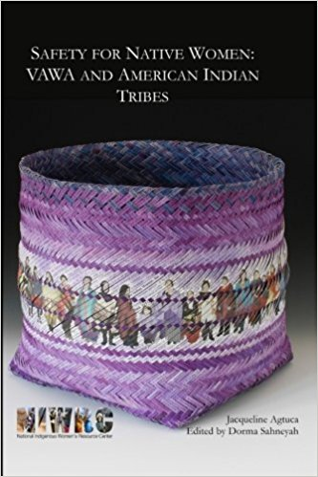
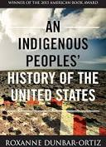
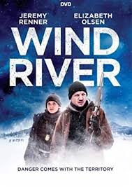
Resources and Recommendations

Slide 25
References
Deer, Sarah, (2015). The Beginning and End of Rape: Confronting Sexual Violence in Native America. University of Minnesota Press.
Futures Without Violence. (n.d.). “Violence against AI/AN women.” Retrieved from https://www.futureswithoutviolence.org/userfiles/file/Violence%20Against%20AI%20AN%20Women%20Fact%20Sheet.pdf
Malcoe, L.H. & Duran, B.M. (2004). Intimate partner violence and injury in the lives of low-income Native American women. Family Violence and Violence Against Women. Retrieved from http://www.ncjrs.gov/pdffiles1/nij/199703.pdf
Medicine, Beatrice. Learning to Be an Anthropologist & Remaining “Native.” Chicago: University of Illinois Press, 2001.
National Institute of Justice. (2010). “National intimate partner and sexual violence survey.” Retrieved from https://www.cdc.gov/violenceprevention/pdf/nisvs_report2010-a.pdf
National Indigenous Women’s Resource Center. (October 2016). “Restoration: Justice for missing and murdered native women and girls.” Retrieved from http://www.niwrc.org/files/Restoration-V13.3.pdf

Slide 26
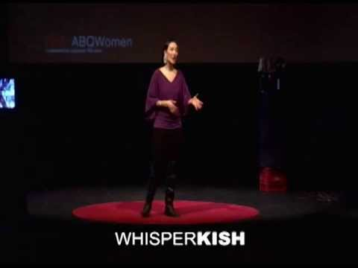
Ted Talk:
Whisper Kish

